Slide 1


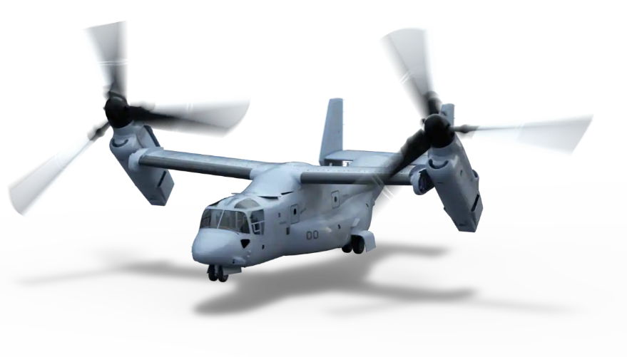
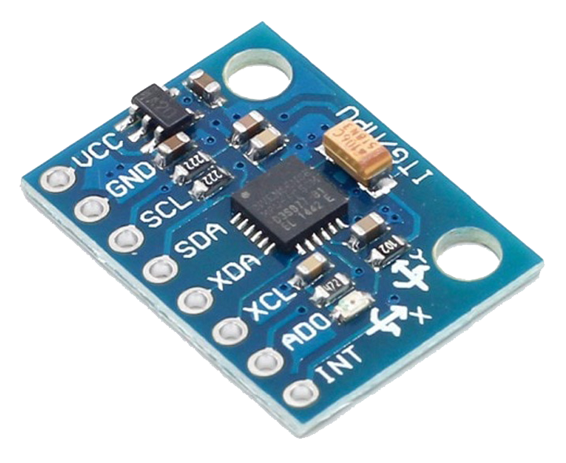
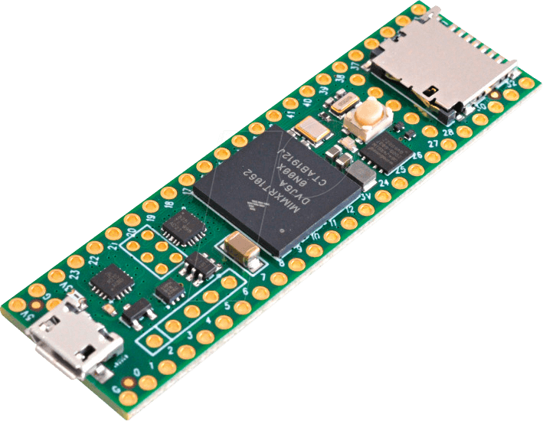
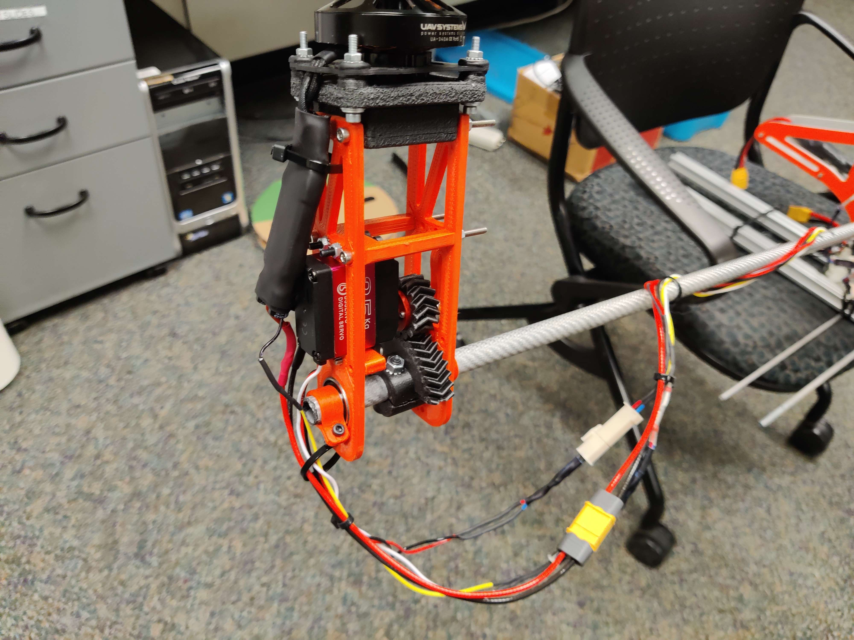
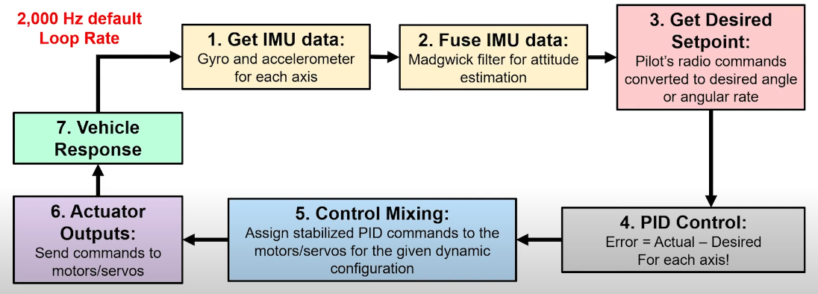
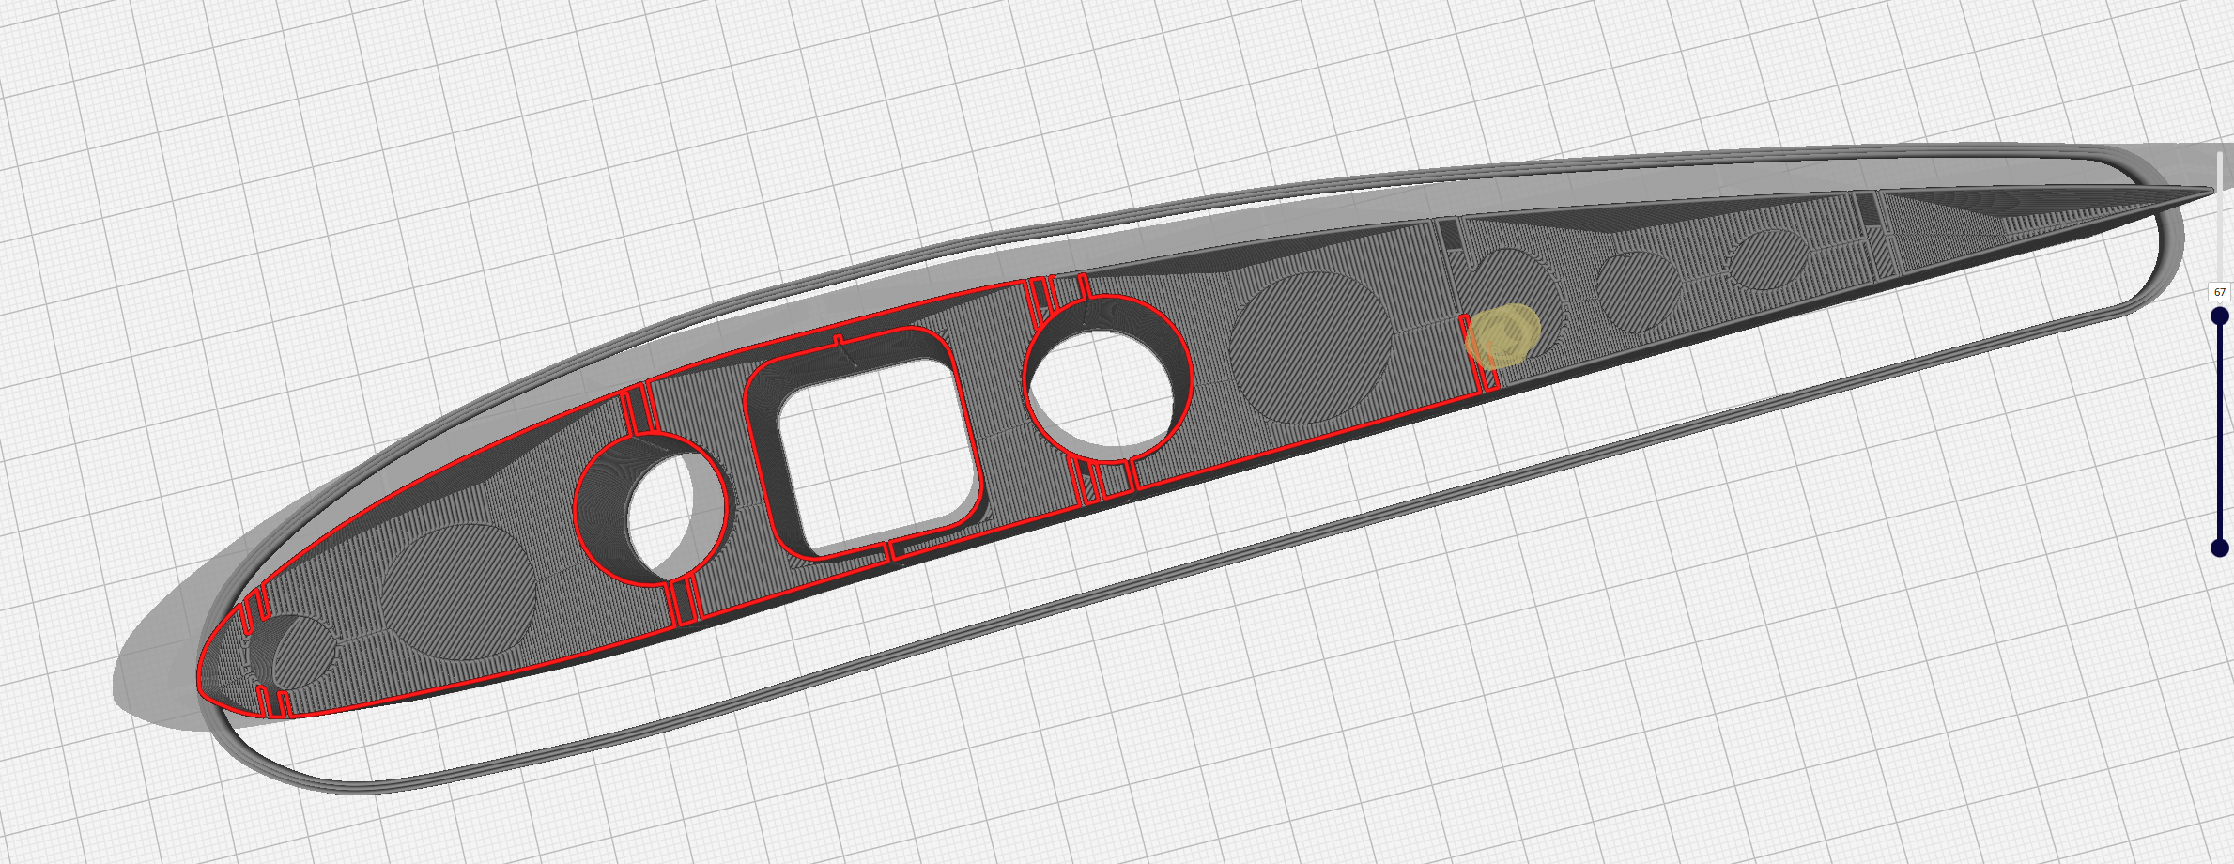
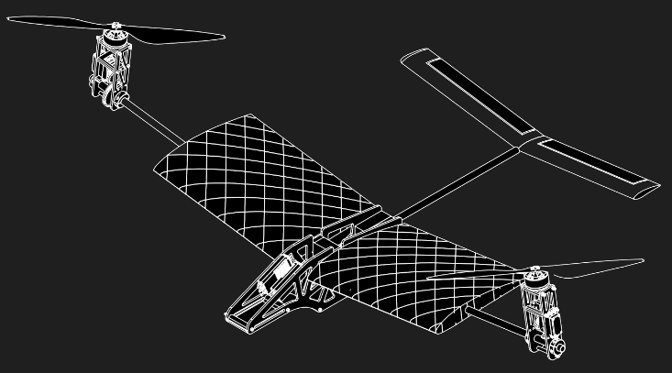
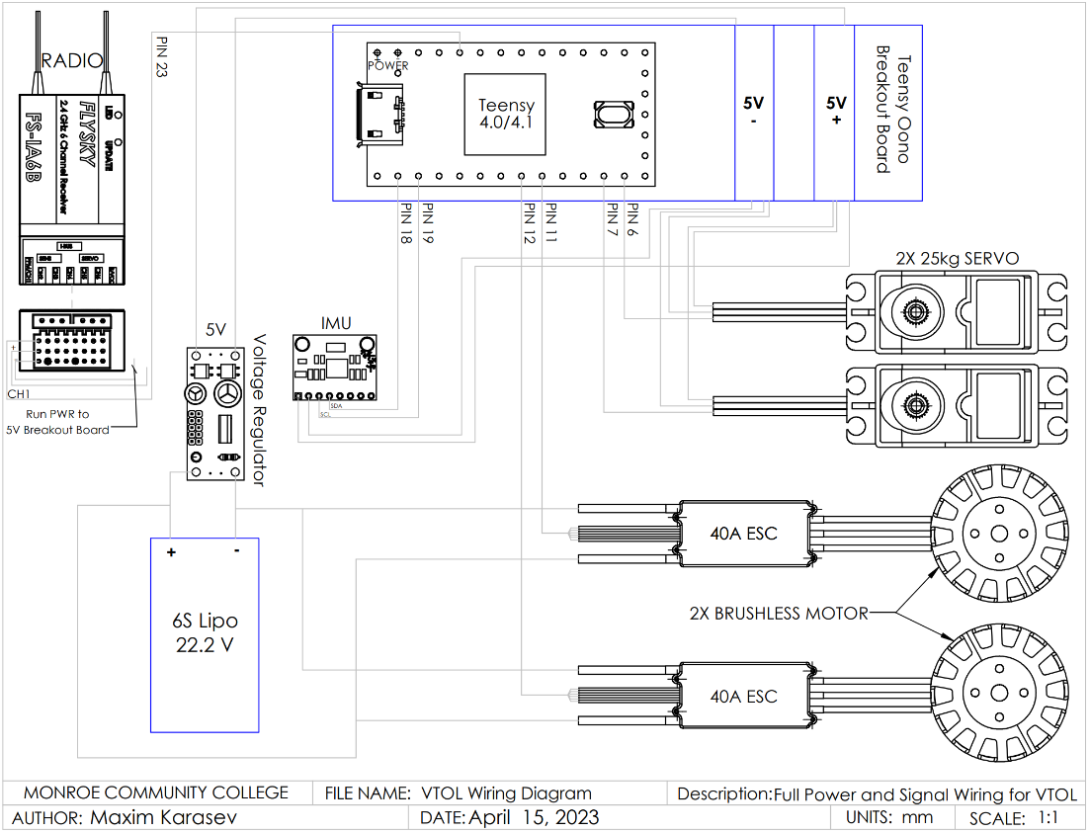
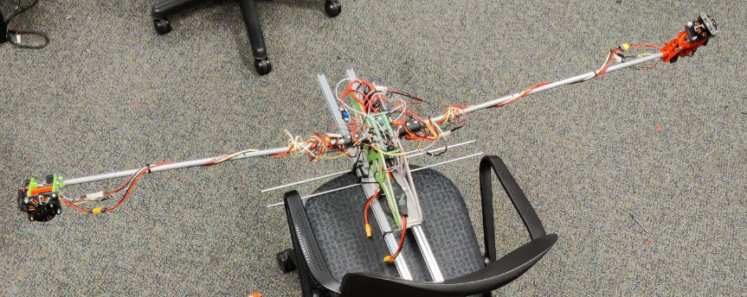
2023 MCC – Scholars’ Day Maxim Karasev, Omar Nadeem, and Peter Cetner Department of Engineering Science & Physics, Rochester NY 14623
PROJECT
The goal was to prototype a vertical take off and landing aircraft (VTOL) in the wing-tipped motor configuration. The inspiration closely resembles that of a Boeing V22 Osprey. Where it has two motors to take off vertically and hover like a drone but can then transition into forward flight like a plane.
VTOL OPERATION
The VTOL runs on a Teensy 4.1 (Arduino) microcontroller using dRehmFlight software. This gives the aircraft the capabilities of achieving the movements it requires. For hovering for example, the Teensy will take the information from an inertial measurement unit (IMU) on its orientation, and automatically adjust the tilt that is run by a servo and gear mechanism along with the motor speed to stay in hover. Additionally, this will allow it to tilt the motors for forward flight.
DESIGN ANALYSIS
Testing 1 (Hover Test) was successful after needing to push it back by a couple of weeks due to the size of the project. We encountered prototyping issues such as designed part failures, wiring, and code issues. The whole design was made from scratch. With that in mind, we did not accomplish Testing 2 (Forward Flight) as of date.
The total cost of making this VTOL was $692.26. Though, some parts were reused from MCC drone team which would drive the cost. We ideally wanted our parts machined instead of PLA for the body, and tilt-mechanism. We had to replace the motors due to the them being a reuse of an old hex-copter. That drew the cost an additional $255.98.
The code loop for how the dRehmFlight software is shown, and the NACA 4412 Airfoil went through the most iterations due to the rib structure and trying to achieve vase mode 3D printing.
When we compare the VTOL to a regular quadcopter of the same size, we learn that it uses less power to achieve the same distance because it is using half the motors and can achieve forward flight with the airfoil where it is most efficient by gliding to maintain lift instead of only relying on the power of the motors.
CONCLUSION/DISCUSSION
With what we learned as a team, we feel confident that along with the documentation we can allow the MCC drone team design an upscaled version of the VTOL to compete in the SUAS competition. This will give us an advantage when compared to other fixed wing and multirotor drones. The team went through many setbacks in prototyping the VTOL, but with those setbacks and experiences we went through, the future team will be able to build upon it.
DESIGN EVOLUTION
We started the project by first wanting to acquire a regular fixed-wing aircraft and attaching four motors to make it a VTOL. However, after doing some research, we found the possibility of making a wing-tipped motor configuration where it relies on a tilting mechanism and elevator to do all three necessary movements for flight: pitch, roll, and yaw. This can be done with just two motors which makes the project more complex and interesting, but ultimately a superior configuration. When it comes to designed parts, we had to go through many versions of a part due to failures, one example being our gear mechanism where the forces from the servo caused it to crack and break overtime during testing.
FABRICATION
We used SolidWorks to design the mechanical side of the VTOL, and 3D printed most of it in PLA. The airfoil was designed using Fusion 360 with its own rib structure in lightweight PLA. The carbon fiber and electronic components were sourced, and we soldered everything together.
IMU
TEENSY
Tilt-mechanism
NACA 4412 Airfoil
WIRING DIAGRAM There is a 6S lipo battery that runs directly to the electronic speed controllers and motors. The rest of the electronics are
powered by 5V breakout board that is received from a voltage regulator.

